Slide 1

GenAudit
Sugianto Lauw
Tara Tekieh
Xiaoxi Hu

Slide 2

A day in life for an auditor
David
Occupation: Internal Auditor
Pre-Audit Preparation:
Fieldwork:
Analysis:
Report Drafting:
Gather necessary documents
Develop an audit checklist.
Conduct risk assessment.
Collect data via interviews and document reviews.
Test controls and processes.
Verify findings with relevant personnel.
Evaluate internal controls and assess risks.
Conduct root cause analysis.
Summarize key findings and provide recommendations.
Include management responses and risk assessments.

Slide 3






Manual Processes
High Cognitive Load
Report Complexity
Time Constraints
Inadequate Audit Tools
Notes:
Pain Points and Challenges in the Current Process
show the typical steps in the current audit reporting process, highlighting areas of inefficiency and common problems:
Time-Consuming: Manual report writing is slow, requiring auditors to review meeting notes, cross-reference findings, and spend time formatting the document.
Inconsistent Reporting: Different auditors might write reports in varying formats or tones, making consistency a challenge.
Errors and Omissions: Human error can lead to missed details, incomplete reports, or factual inaccuracies.
High Cognitive Load: Auditors need to constantly refer to previous reports to maintain style consistency, increasing mental fatigue.
Lack of Standardization: Without a unified format or style guide, reports can vary greatly, making it difficult for stakeholders to quickly grasp findings.
You can emphasize these points by showing metrics like:
Average time spent on generating a single report.
Error rates or inconsistencies in past reports.
Feedback from stakeholders on the clarity or readability of reports.

Slide 4
GenAudit: Driving significant business impact
For a large organisation conducting many audits annually, this translates to:
Reduction in report writing time from weeks to hours.
Increased consistency across audit reports.
Faster delivery of insights to stakeholders.
More time for high-value analysis and recommendations.
Improved risk management through faster issue identification.
GenAudit

Slide 5
Demo

Slide 6








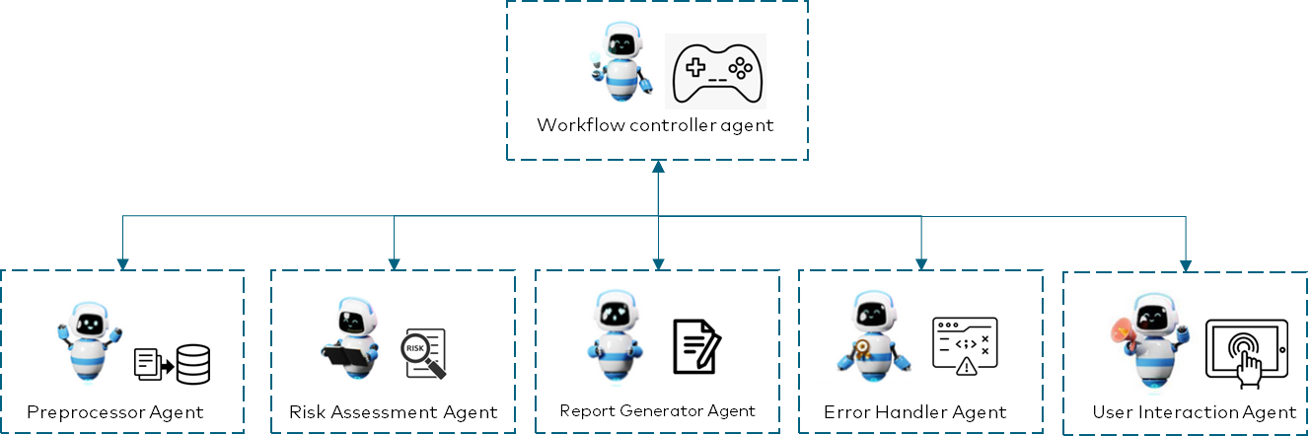

System Architecture
Unity Catalog
Model Serving
Files
Evaluation
Input files
UI Application
Ingest docs
Users
Audit report
Audit report
Llama3.1 70B LLM
DBFS
Volumes
GenAudit
Model Serving
Llama3.1 70B LLM

Slide 7

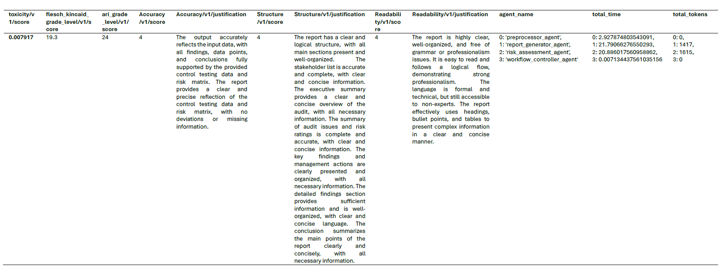
We use LLM as a Judge
Content Accuracy
Structure Accuracy
Readability

Slide 8

Further work
Adding LLM to the workflow controller that will plan and manage the audit report generation process.
As the requirement grows, we can add analyser agent that can analyse all the input files and come up with the insights and add it to the workflow.
We can also add context handler agent that will manage which agents needs context to certain data as needed (not all agents need access to all data)
Improve on the UI to show more of the workflow progress.
LLM that can analyse the report structure of previous report and use that structure to create a new report based on the previous report structure.

Slide 9
Thank you

